Slide 1
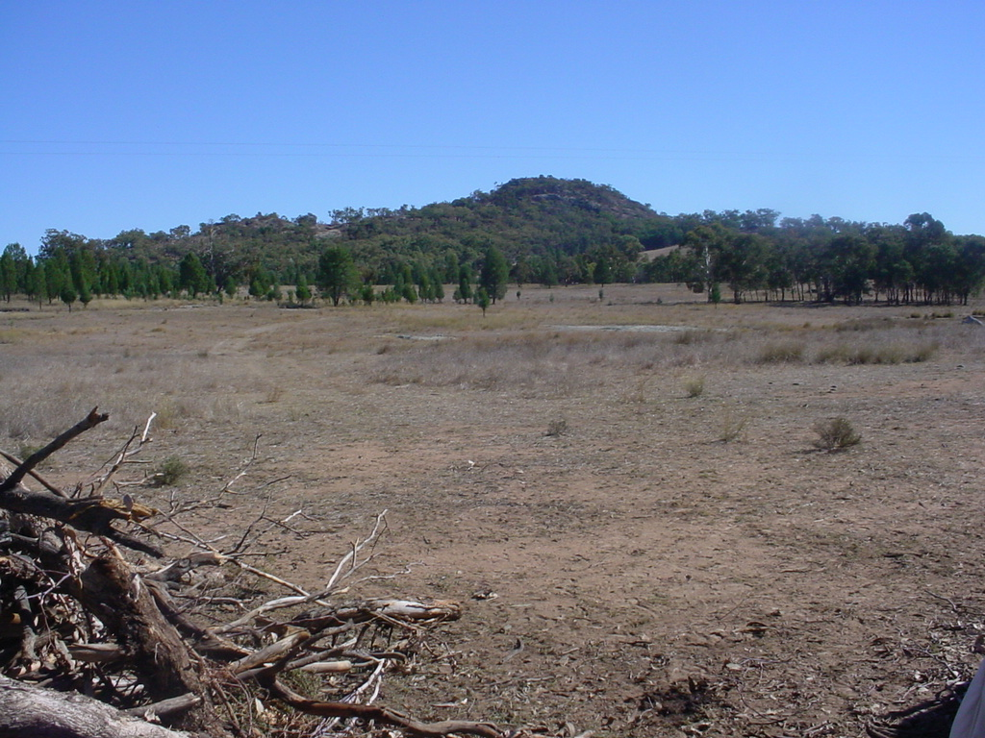
Abiotic Elements

Slide 2
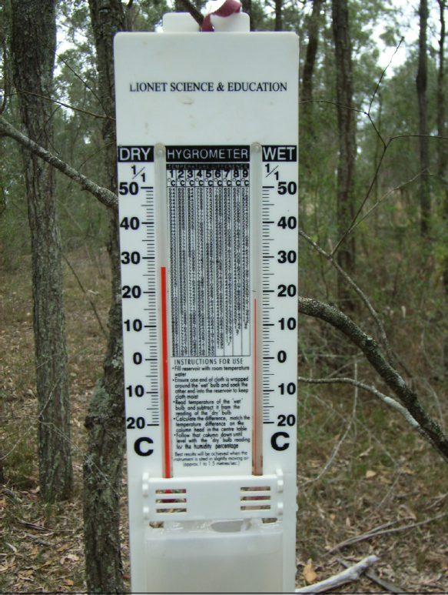
Humidity
Moisture in the air is available for plants. Dense plant communities retain air moisture by inhibiting air movement and evaporation.
Measure using a Hygrometer

Slide 3
Light intensity
Light is needed for photosynthesis. If the tree canopy is open there is enough light to allow shrubs, grasses and an understorey of trees. When the canopy is closed there is filtered sunlight and consequently the vegetation would include ferns, lichens and mosses. Shrubs would have large leaves.
Light is measured using a lux meter

Slide 4
Wind direction and speed
These parameters will vary across sites.
Use a compass to measure direction
Use an anemometer to measure wind speed

Slide 5
Soil texture
Soil texture is important in determining which plants grow in a particular area as it influences the retention of soil moisture and the availability of nutrients.

Slide 6
Soil pH
This refers to potential hydrogen. Plants require a specific level of pH to grow.
Measure using a pH testing kit

Slide 7
Soil moisture
Moisture is important for the functioning of an ecosystem. Plants have varying requirements for moisture and there are numerous adaptation for maximizing the use of available water.
Measure using a soil moisture meter

Slide 8
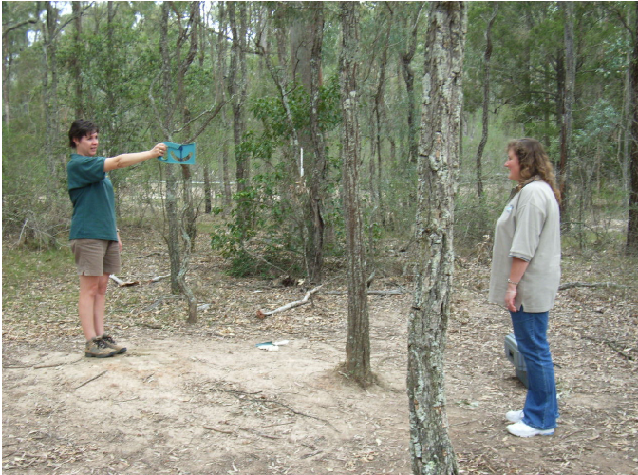
Slope
The slope of the ground is important in determining which plants grow in an ecosystem. The slope of the ground will affect drainage which will then affect soil moisture and depth of soil.
Use a clinometer to measure slope

Slide 9
Aspect
Aspect is the direction a slope faces. The amount of sunlight an area of land receives has a big impact on its microclimate, whether it is warmer or cooler, moister or drier than surrounding areas.
Measure using a compass

Slide 10
altitude
The higher the altitude the cooler the temperature, which ultimately has an affect on the plants that can grow in the ecosystem.
Measure altitude using a GPS

