Slide 1
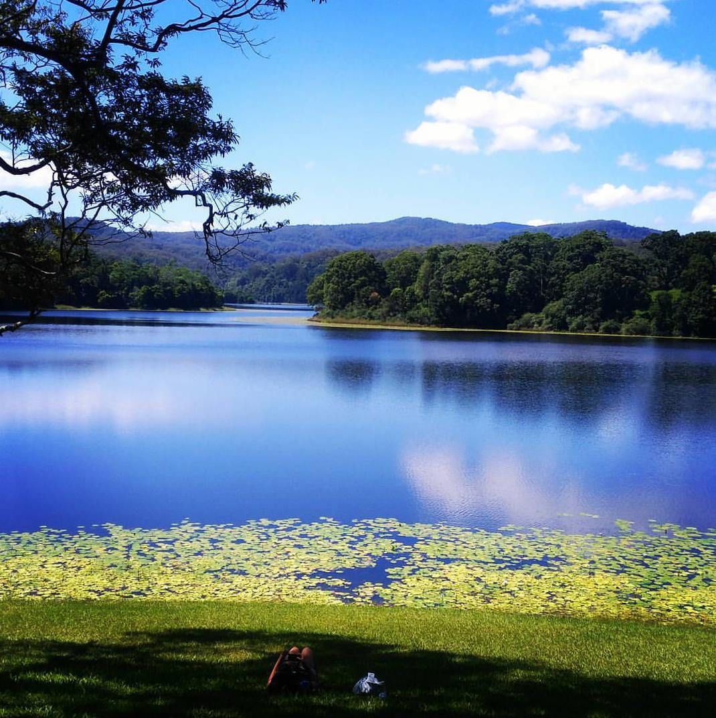
Biotic & Abiotic Elements

Slide 2
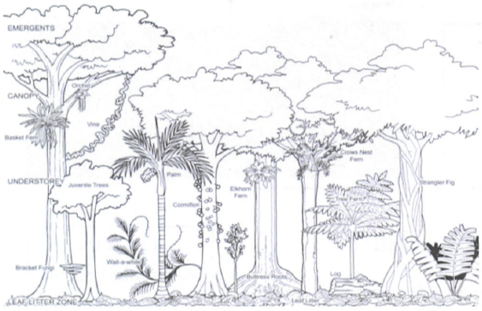
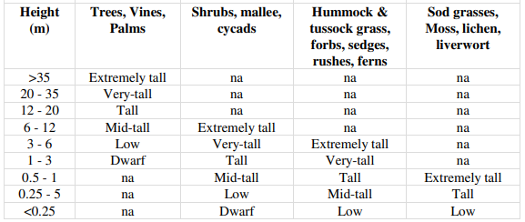
Canopy Cover

Slide 3
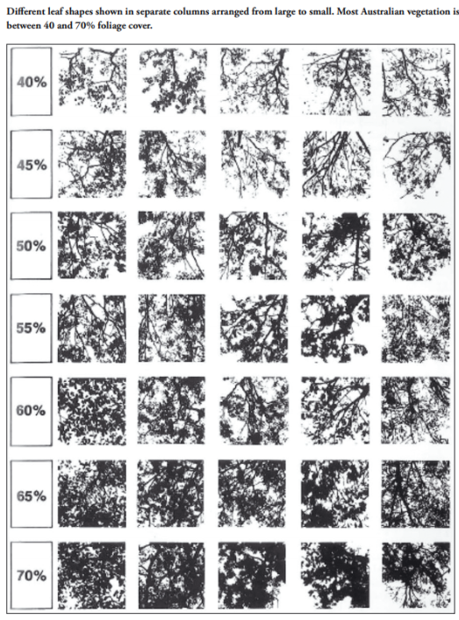
Canopy Cover Procedure

Slide 4
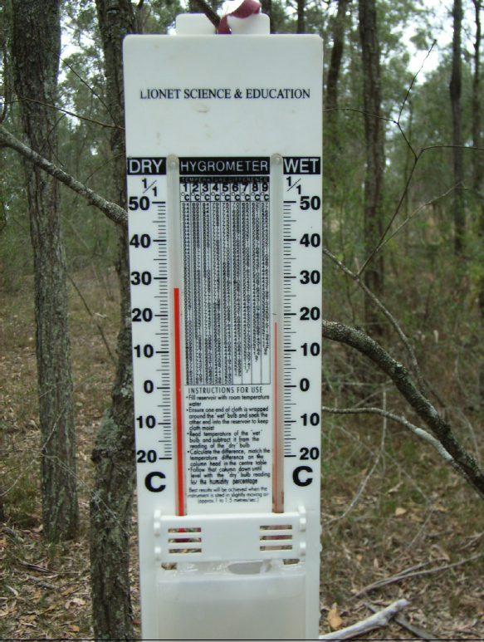
Humidity
Moisture in the air is available for plants. Dense plant communities retain air moisture by inhibiting air movement and evaporation.
Measure using a Hygrometer

Slide 5
Humidity Procedure
Read and record temperature of the wet bulb thermometer in degrees Celsius.
Read and record the temperature of the dry bulb thermometer(degrees Celsius).
Calculate the difference in temperature readings between the wet and dry thermometers.
Use the conversion scale to determine the humidity or interpret the temperature differences: follow down column of correct difference until you reach the current temp on dry bulb.
This percentage reading is the current humidity.
Record on worksheet.

Slide 6
Amount of Light(Light intensity)
Light is needed for photosynthesis. If the tree canopy is open there is enough light to allow shrubs, grasses and an understorey of trees. When the canopy is closed there is filtered sunlight and consequently the vegetation would include ferns, lichens and mosses. Shrubs would have large leaves.
Light is measured using a lux meter

Slide 7
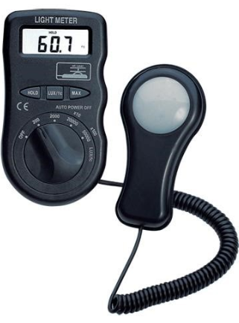
Measuring Light Intensity
Place scale button on x 100.
Turn on power.
Remove cover from light sensor and hold sensor upwards & flat.
If sunny, place sensor in shade and take a reading. Then place in the sun and take a reading. Average the result and multiply this number by 100. Record your Light meter reading result in LUX.
If overcast, any situation for the sensor is appropriate.

Slide 8
Wind direction and speed
These parameters will vary across sites.
Use a compass to measure direction
Use an anemometer to measure wind speed

Slide 9
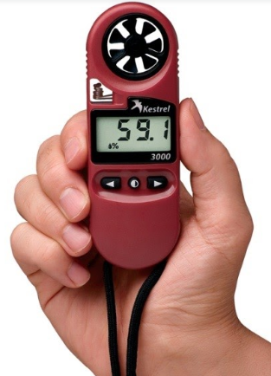
Measuring Wind Speed
Turn anenometer on.
Select the wind speed icon.
Face meter into wind
Measure wind direction using a compass
Record Wind Speed in kilometres per hour in your booklet

Slide 10
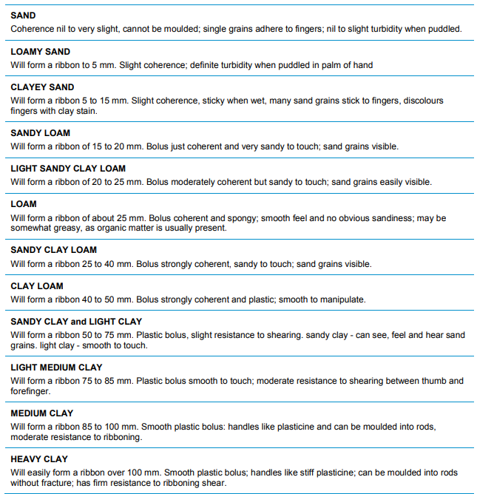
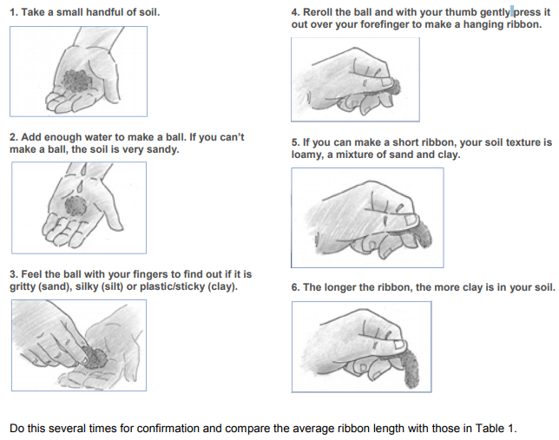
Soil texture procedure
Soil texture can be estimated by hand, using the ribboning technique, but it takes practice to produce a consistent result.
NSW Department of Primary Industries 2015

Slide 11
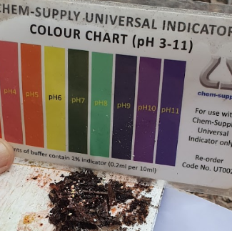
Soil pH
This refers to potential hydrogen. Plants require a specific level of pH to grow.
Measure using a pH testing kit

Slide 12
Soil pH Procedure
Place tiny amount of soil on your tile.
Moisten soil with a few drops of Universal indicator
Sprinkle Barium Sulphate over dampened soil
Wait a few minutes before taking a reading using the pH colour chart

Slide 13
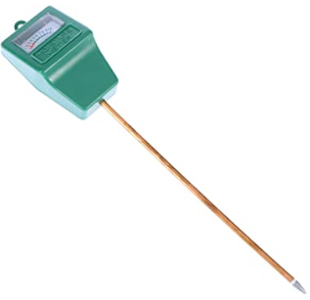
Soil Moisture procedure
Moisture is important for the functioning of an ecosystem. Plants have varying requirements for moisture and there are numerous adaptation for maximizing the use of available water.
Insert soil moisture meter carefully to a 15 cm depth
Record result.

Slide 14
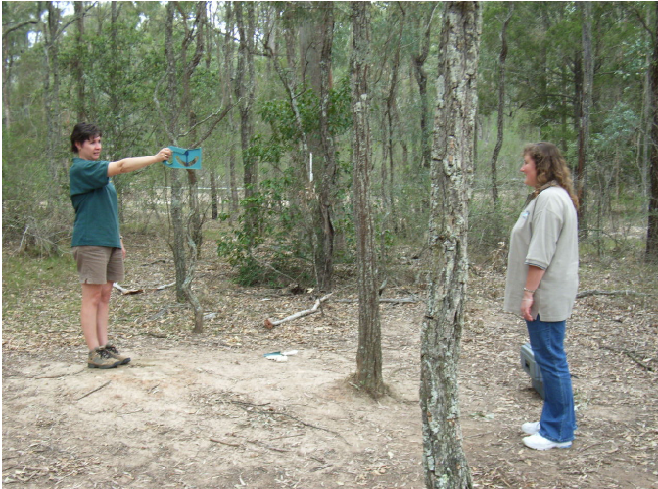
Slope
The slope of the ground is important in determining which plants grow in an ecosystem. The slope of the ground will affect drainage which will then affect soil moisture and depth of soil.
Use a clinometer to measure slope

Slide 15
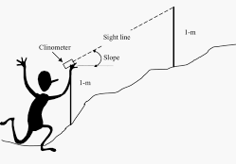
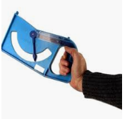
Clinometer procedure
A clinometer is like a mathematical protractor
Stand about 5 metres apart with a partner of similar height up or down the slope
Line up the sight on the clinometer with your partners eyes while holding trigger on instrument
Once steady release trigger and take/record measurement in degrees.

Slide 16
Aspect
Aspect is the direction a slope faces. The amount of sunlight an area of land receives has a big impact on its microclimate, whether it is warmer or cooler, moister or drier than surrounding areas.
Measure using a compass

Slide 17
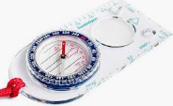
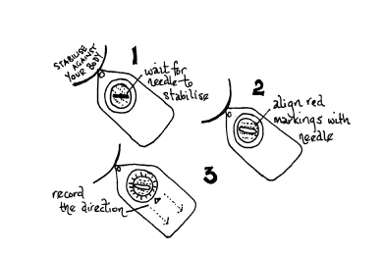
Procedure to measure Aspect using a Compass
Hold the compass facing up with the tag towards your body.
Hold the compass flat and parallel to the ground.
Aim the square end of the compass down slope.
Wait for the magnetic north needle to stop moving.
Turn the round dial to align the North marker with the needle.
Read the direction on downhill on the dial.
Record the direction as NW, ESE, etc.
This direction is the aspect of your slope.

Slide 18
Altitude
The higher the altitude the cooler the temperature, which ultimately has an affect on the plants that can grow in the ecosystem.
Measure altitude using a GPS

